Slide 1
Intro to AI for Medicine
Lec 2: Math

Slide 2
1980s/1990s: Backpropagation
Where we left off…
Notes:
Last time we ended here.
We were going thru the history of AI, and wanted something that could
1. Could set a goal
1. Learn and improve over time toward that goal

Slide 3
Today’s Agenda
Tips for success
Scalars, vectors
Matrices and matrix operations
Tie it back in with the neuron
Gradient descent
Notes:
A bit of a digression from medicine, but I promise it’s important.
We need these tools to do good analysis during the rest of the semester.

Slide 4
Housekeeping
Attendance tracker in the drive – if zoom picked you up I added you
Matt will take attendance this lecture
If you’re taking for credit and not on there lmk

Slide 5

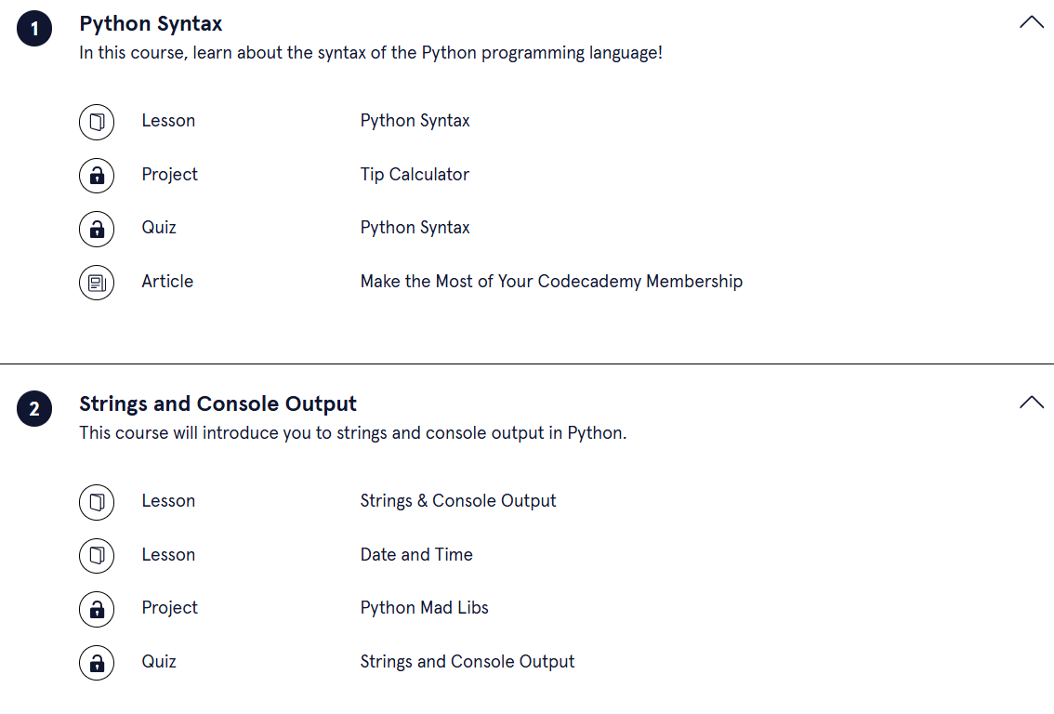
Housekeeping: Python Gang
OH with Matt for python after class,
OH with me for AI after class.

Slide 6
Tips
Let’s take it slow
Try to understand how the pieces connect
Long-term, not necessary to remember everything about this stuff
We’re just trying to understand where the basic building blocks of ML come from
General theme: Math has meaning
Ask questions!
Notes:
The way we define certain concepts mathematically has a massive impact on the outcomes of our system
We are going to blast past a ton of math and get right to what we need for AI
This is kind of like the biochemistry lecture in med school, often abstracted past but useful background to have for life

Slide 7

Scalar vs Vector
Notes:
Regular number 3: A magnitude.
Sufficient information to answer my question

Slide 8


Scalar vs Vector
1 km
Notes:
Can you say 3?
Need a base, and a scalar.
Introduced a new piece of information here.

Slide 9
Scalar vs Vector
Notes:
How do I get to your house?
Go 3 blocks east, 1 block north.
Added new piece of info, directionality.

Slide 10
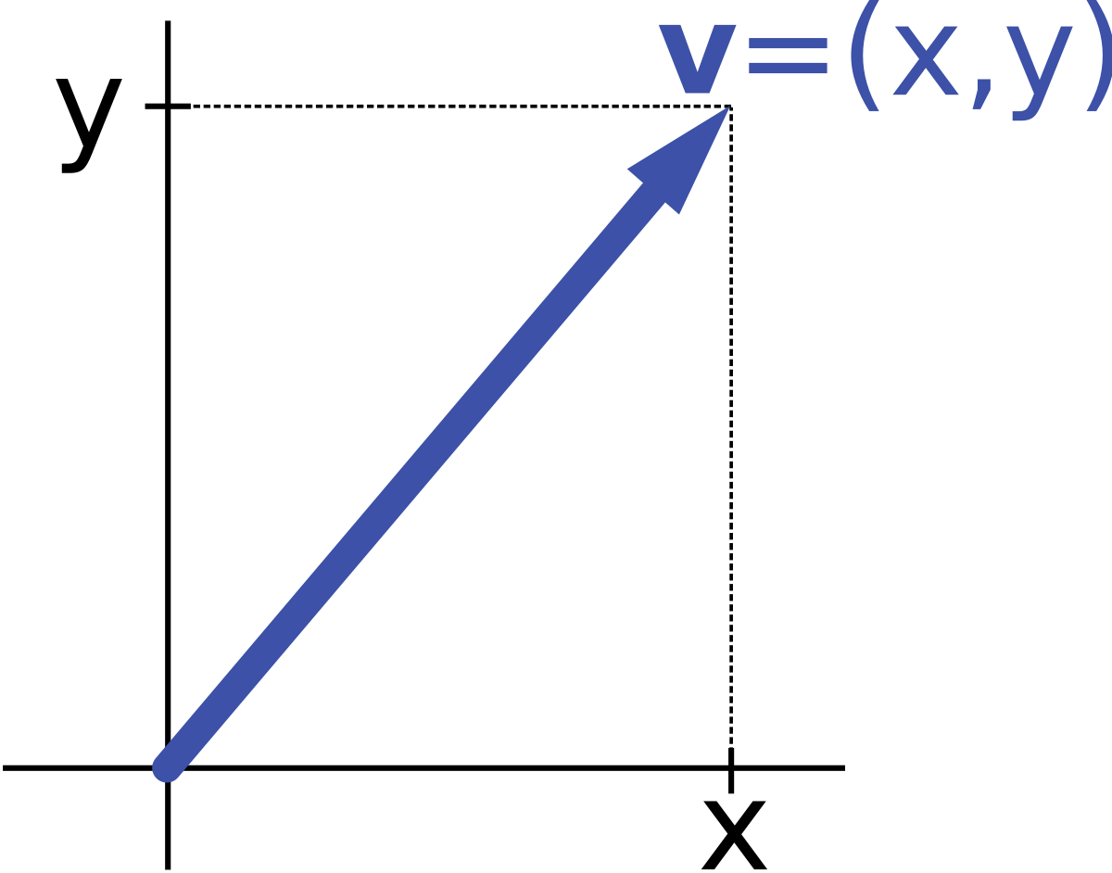
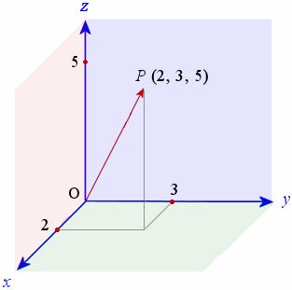
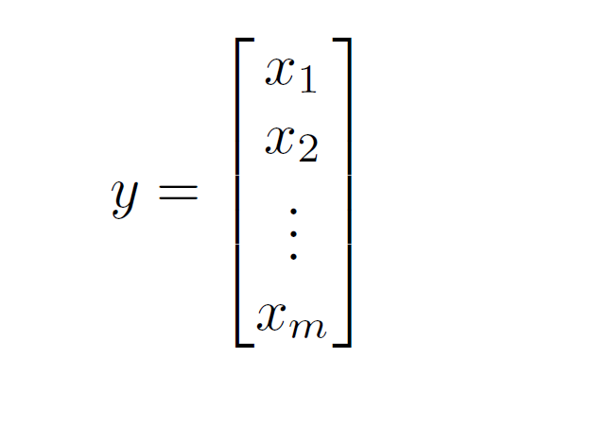
Vectors
Mathematical object with direction + magnitude
Direction: like slope
Magnitude: length of hypotenuse of triangle w legs x, y
If no direction, it’s called a scalar.
Can have many dimensions
Notes:
Direction: where we point
Magnitude: how far we point that way

Slide 11


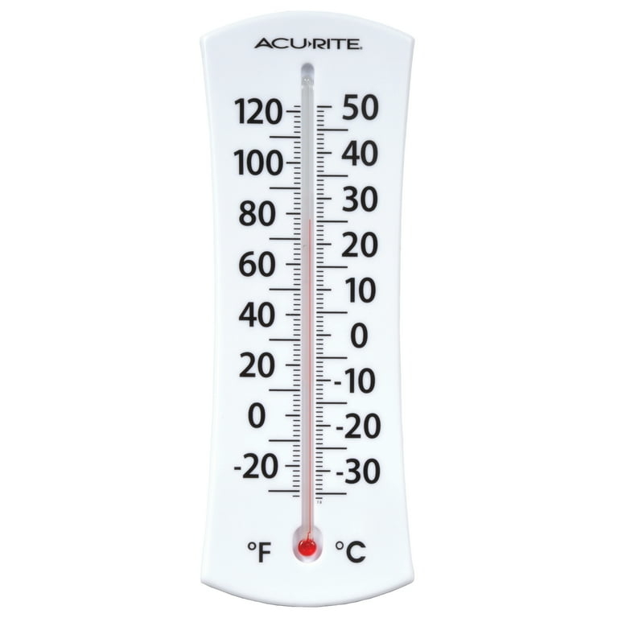
Vector Representations
Anything with direction and magnitude!
Movement, force, velocity, acceleration
Notes:
Temperature isn’t a vector, but change in temperature is.

Slide 12
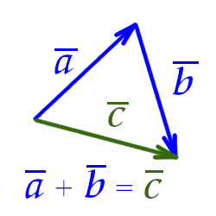
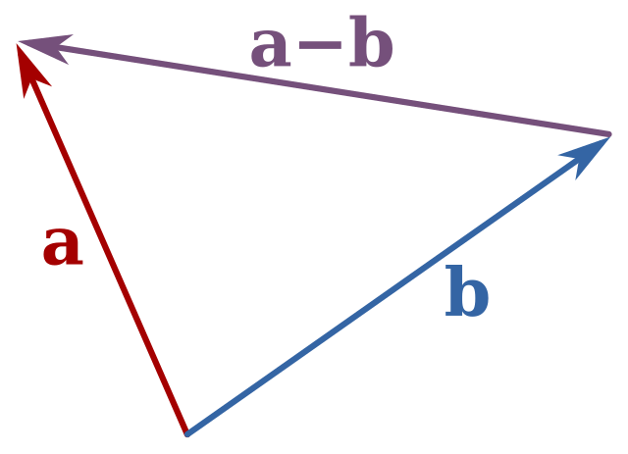
Vector Operations: Addition and Subtraction
Never used in AI – we’re blasting past these

Slide 13
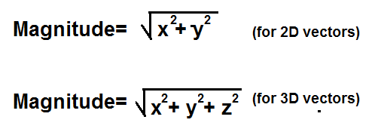

Vector Operations: Computing Magnitude
For vector <2,2>, $\sqrt{8}$

Slide 14
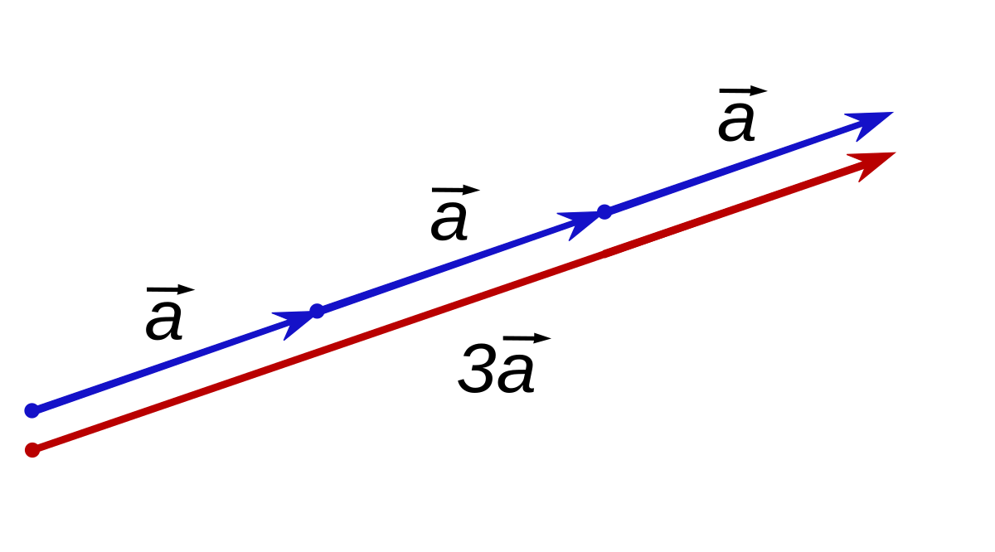
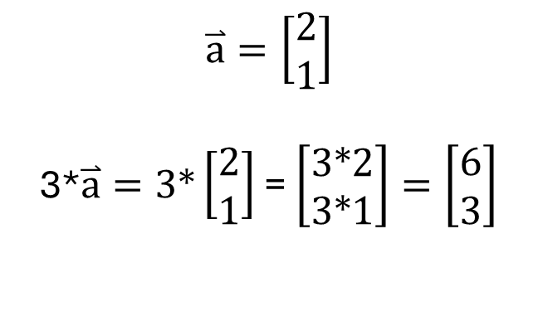
Vector Operations: Scalar Product
$$\overset{⃑}{a}=\left[\begin{matrix}2 \\ 1\end{matrix}\right]$$
3*$\overset{⃑}{a}=3∗\left[\begin{matrix}2 \\ 1\end{matrix}\right]$ = $\left[\begin{matrix}3∗2 \\ 3∗1\end{matrix}\right]=\left[\begin{matrix}6 \\ 3\end{matrix}\right]$
Notes:
Note that we’re changing the magnitude, not the direction.

Slide 15
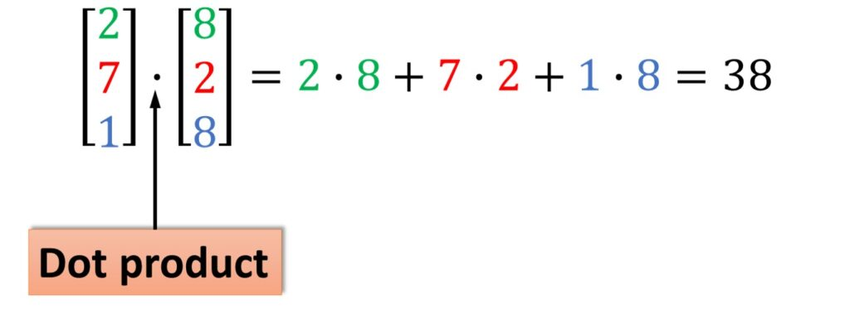

Vector Operations: Dot Product

Slide 16
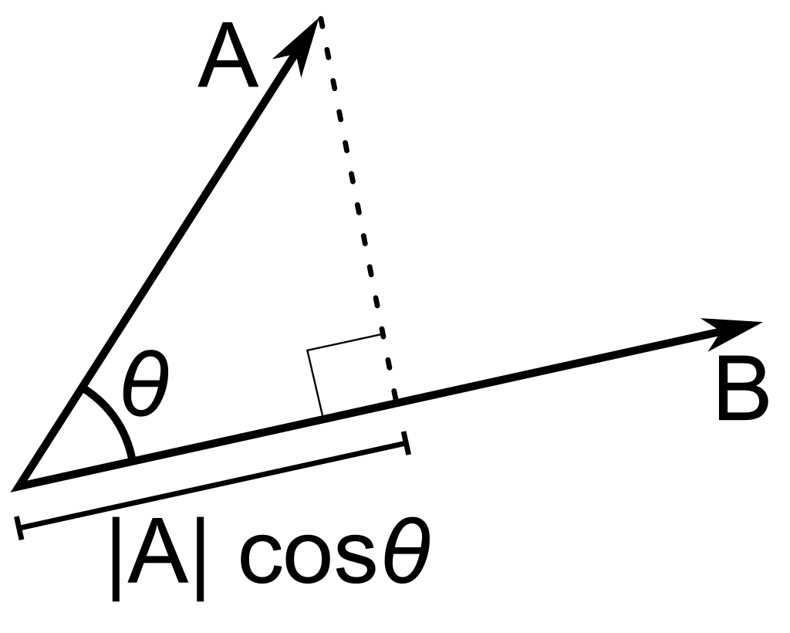

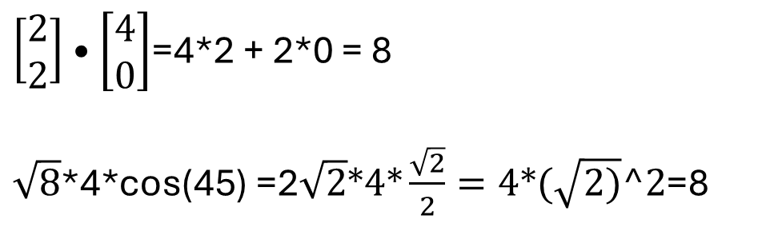
Vector Operations: Dot Product
$\left[\begin{matrix}2 \\ 2\end{matrix}\right]•\left[\begin{matrix}4 \\ 0\end{matrix}\right]$=4*2 + 2*0 = 8
$\sqrt{8}\text{∗4∗}\text{cos}\text{(45) =2}\sqrt{2}∗4∗\frac{\sqrt{2}}{2}=4∗(\sqrt{2)}^2$=8
Notes:
Geometrically, a projection of one vector onto another.
Can tell you how similar your data is

Slide 17
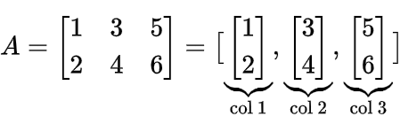
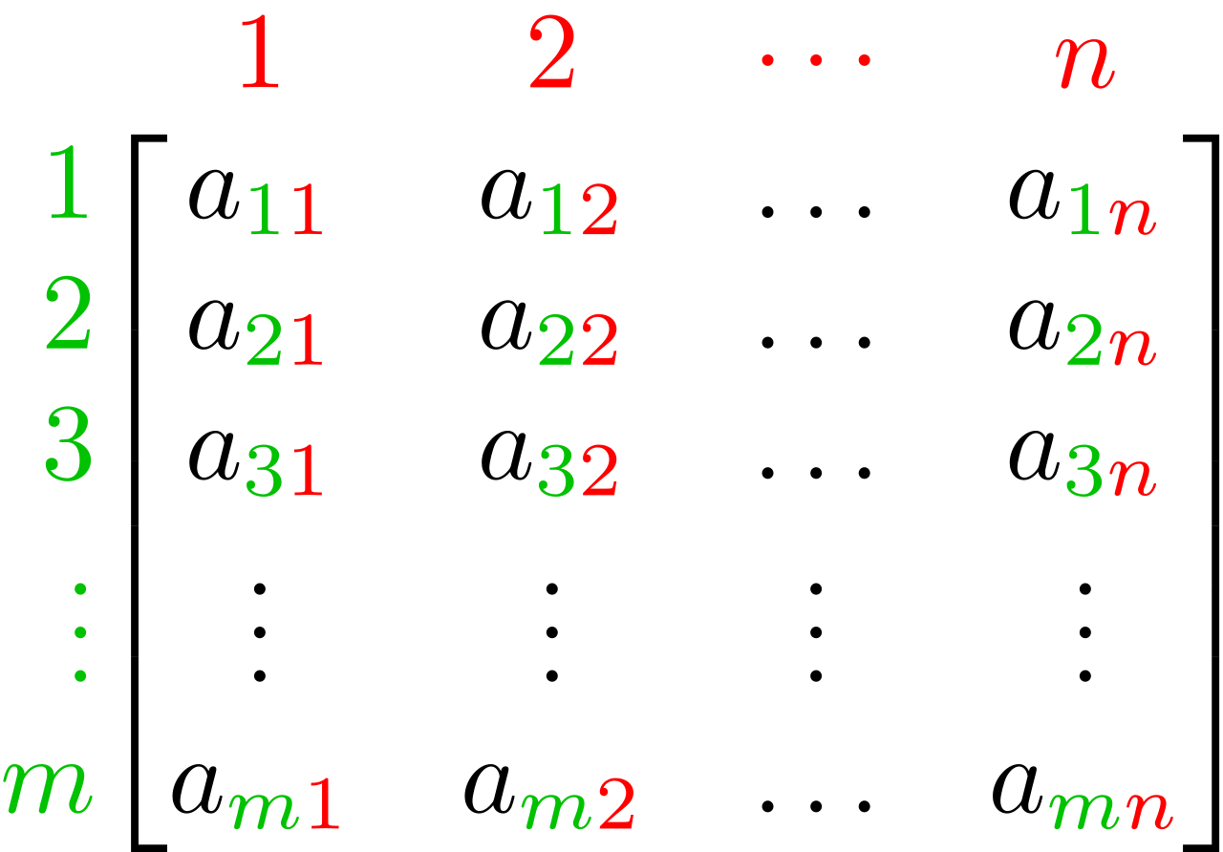
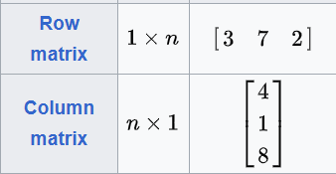
Matrices
Bundle of vectors!
Extension of vector to 3d
The n by m matrix A
Notes:
If a matrix has dimension 1, it’s a vector.
Each row or column can be thought of as a vector.

Slide 18
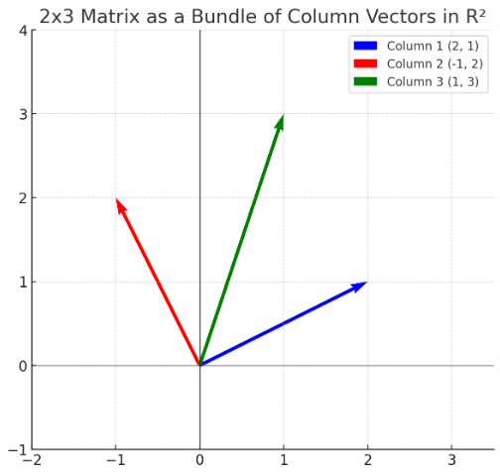

Matrices: Visualized

Slide 19
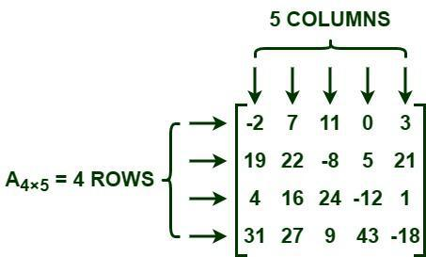

Matrices: Notation

Slide 20

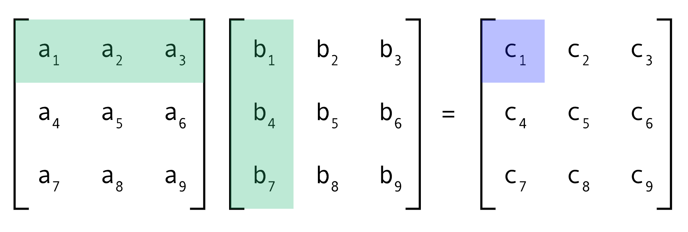

Matrices: Multiplication
A
B
C
a₁*b₁+ a₂*b₄+ a₃*b₇= c₁
Notes:
We really have 9 products in C, then
By doing this, you’ve applied the dot products in B to A in every possible combination.
Now, we can rejoin our story from last lecture.

Slide 21
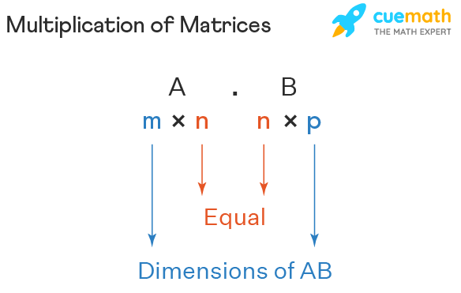
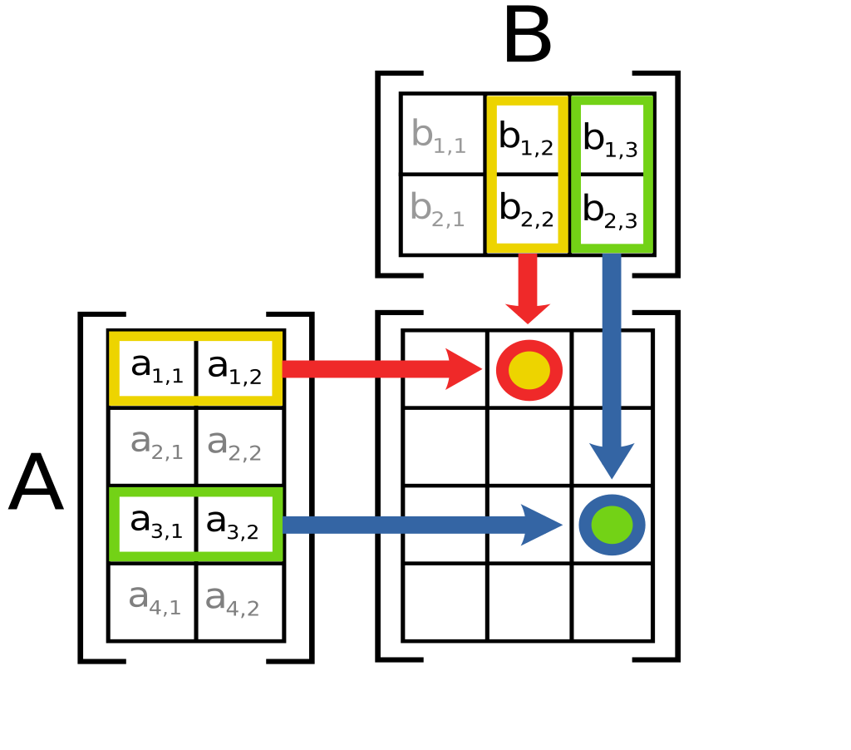
Matrices: Multiplication Rules
2x3
4x2
4x3

Slide 22
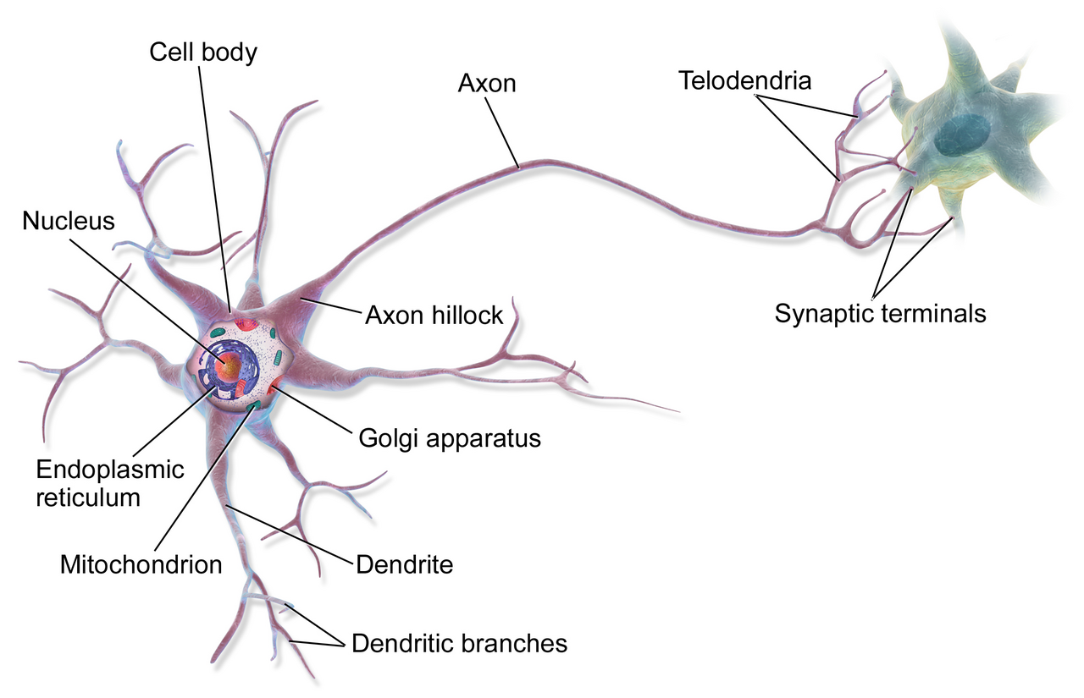
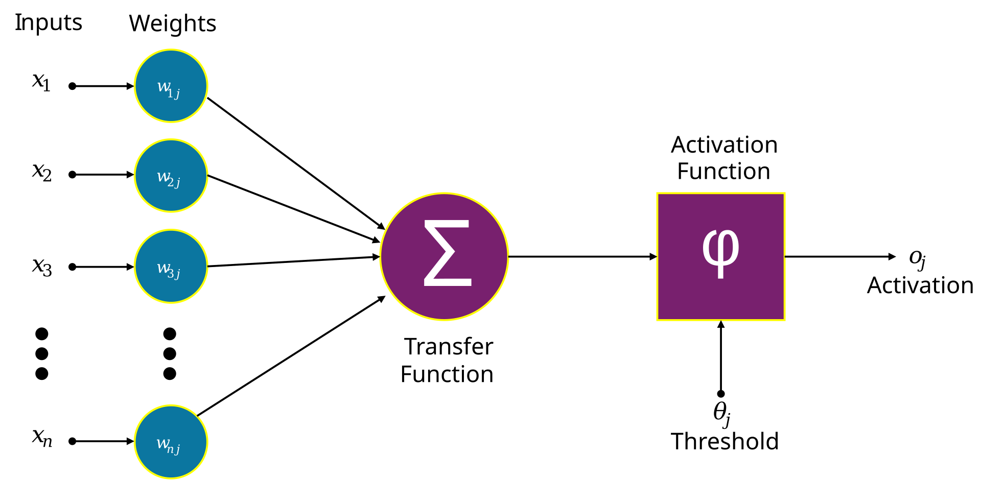
Medicine Inspires AI
1940s – The neuron cell is discovered
Computer scientists wonder – can this be replicated to form the basis of Artificial intelligence?
Notes:
Dendrite, cell body, axon

Slide 23


Revisiting the neuron
$$\left[\begin{matrix}\begin{matrix}x1 & x2\end{matrix} & \begin{matrix}... & xn\end{matrix}\end{matrix}\right]∙\left[\begin{matrix}\begin{matrix}w1 \\ w2\end{matrix} \\ \begin{matrix}⋮ \\ wn\end{matrix}\end{matrix}\right]$$
“Cell body”
“Dendrites”
Notes:
Inputs * weights looks a lot like a vector dot product!
X is our inputs, and the Ws are our weights. We’re performing a matrix operation to give our neuron’s output.

Slide 24
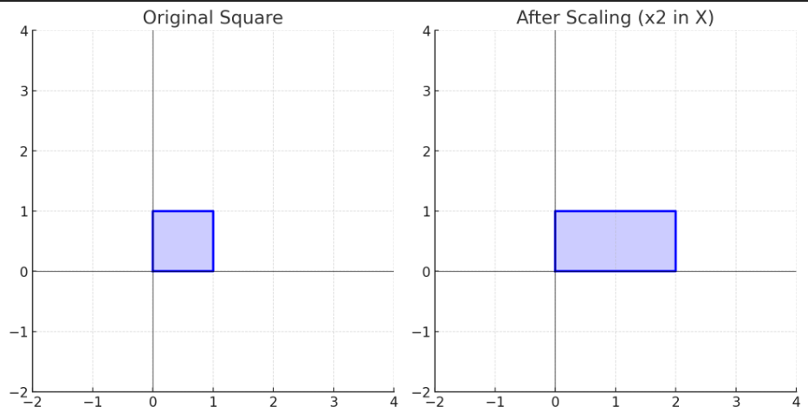

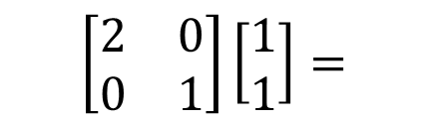
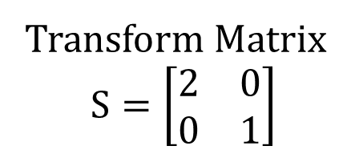
Matrices: Multiplication
Transform Matrix
$$S=\left[\begin{matrix}2 & 0 \\ 0 & 1\end{matrix}\right]$$
Points:
(0,0)
(1,0)
(1,1)
(0,1)
$$\left[\begin{matrix}2 & 0 \\ 0 & 1\end{matrix}\right]\left[\begin{matrix}1 \\ 1\end{matrix}\right]=$$
$$\left[\begin{matrix}2 \\ 1\end{matrix}\right]$$
Outputs:
(0,0)
(2,0)
(2,1)
(0,1)
Notes:
Treat every point like a vector, pointing to it. Only one is pictured here.
What I want to do is multiply every vector representing a point by a transformation matrix.
Let’s only do the example for 1,1

Slide 25
Matrices: Multiplication
Outputs:
(0,0)
(2,0)
(2,1)
(0,1)
Points:
(0,0)
(1,0)
(1,1)
(0,1)
Notes:
Treat every point like a vector, pointing to it. Only one is pictured here.
What I want to do is multiply every vector representing a point by a transformation matrix.
Let’s only do the example for 1,1

Slide 26
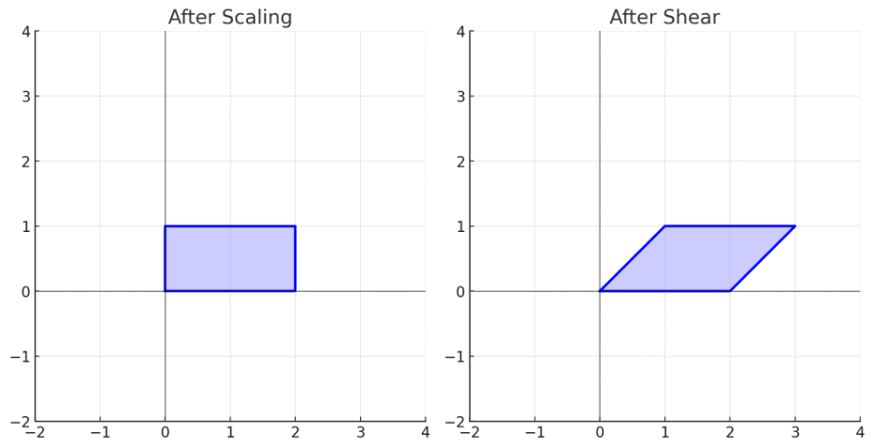
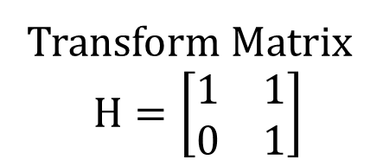

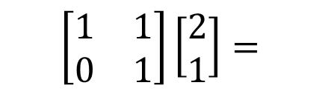
Matrices: Multiplication
Transform Matrix
$$H=\left[\begin{matrix}1 & 1 \\ 0 & 1\end{matrix}\right]$$
Points:
(0,0)
(2,0)
(2,1)
(0,1)
$$\left[\begin{matrix}1 & 1 \\ 0 & 1\end{matrix}\right]\left[\begin{matrix}2 \\ 1\end{matrix}\right]=$$
$$\left[\begin{matrix}3 \\ 1\end{matrix}\right]$$
Outputs:
(0,0)
(2,0)
(3,1)
(1,1)
Notes:
Treat every point like a vector, pointing to it. Only one is pictured here.
What I want to do is multiply every vector representing a point by a transformation matrix.
Let’s only do the example for 1,1

Slide 27
Matrices: Multiplication
Points:
(0,0)
(2,0)
(2,1)
(0,1)
Outputs:
(0,0)
(2,0)
(3,1)
(1,1)
Notes:
Treat every point like a vector, pointing to it. Only one is pictured here.
What I want to do is multiply every vector representing a point by a transformation matrix.
Let’s only do the example for 1,1

Slide 28
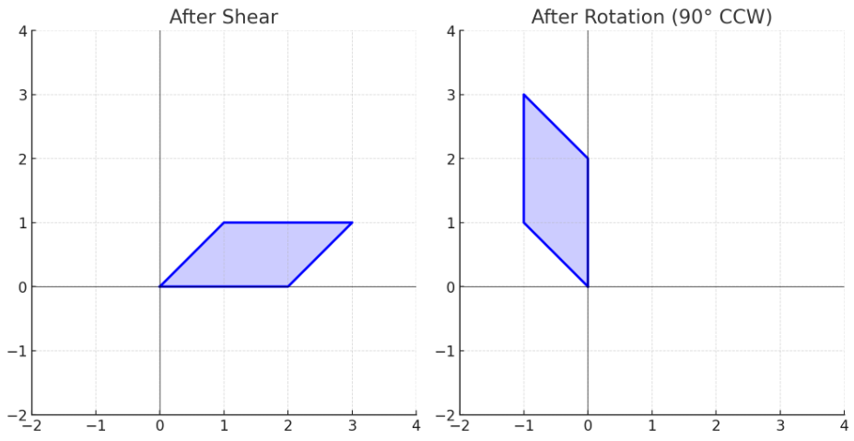
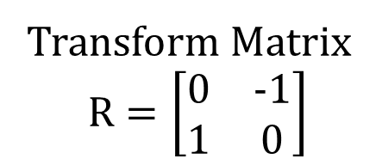

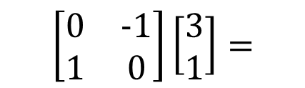
Matrices: Multiplication
Transform Matrix
$$R=\left[\begin{matrix}0 & −1 \\ 1 & 0\end{matrix}\right]$$
Points:
(0,0)
(2,0)
(3,1)
(1,1)
$$\left[\begin{matrix}0 & −1 \\ 1 & 0\end{matrix}\right]\left[\begin{matrix}3 \\ 1\end{matrix}\right]=$$
$$\left[\begin{matrix}−1 \\ 3\end{matrix}\right]$$
Outputs:
(0,0)
(2,0)
(3,1)
(1,1)
Notes:
Treat every point like a vector, pointing to it. Only one is pictured here.
What I want to do is multiply every vector representing a point by a transformation matrix.
Let’s only do the example for 1,1

Slide 29
Matrices: Multiplication
Points:
(0,0)
(2,0)
(3,1)
(1,1)
Outputs:
(0,0)
(2,0)
(3,1)
(1,1)
Notes:
Treat every point like a vector, pointing to it. Only one is pictured here.
What I want to do is multiply every vector representing a point by a transformation matrix.
Let’s only do the example for 1,1

Slide 30
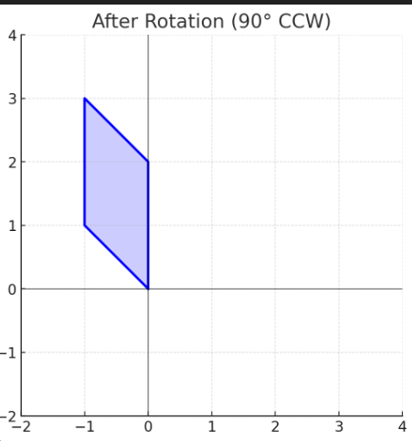
Who Cares?
Notes:
Why does flipping around a parallelogram matter?
Well, what if the initial point values had meaning? Then, the final position could tell us something.
We could say, above a certain threshold, call this a positive.

Slide 31
What If…
Instead of inputs:
(0,0)
(1,0)
(1,1)
(0,1)
And our red line meant:
80% chance of developing afib within 5 years
Our inputs were:
Age: 72
Weight: 133 kg
Max systolic bp last 24h: 172
Family history of atrial fibrillation: yes
So, one point is:
(72, 133, 172, 1)
Notes:
Don’t worry, we’ll have a large part of a lecture on how to convert clinical data to forms that play nice with AI.
We’ve just designed a risk stratification algorithm. This process is known as classification, and we’ll have a whole lecture on it.

Slide 32
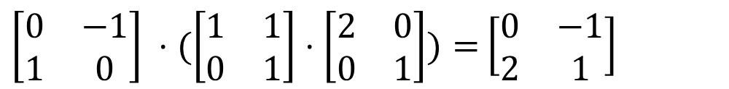
Activation
Combining our matrices from before gives:
So why do multiple steps?
$\left[\begin{matrix}0 & −1 \\ 1 & 0\end{matrix}\right] ⋅(\left[\begin{matrix}1 & 1 \\ 0 & 1\end{matrix}\right]⋅\left[\begin{matrix}2 & 0 \\ 0 & 1\end{matrix}\right])=$ $\left[\begin{matrix}0 & −1 \\ 2 & 1\end{matrix}\right]$
Notes:
So why do multiple steps?
Well, we need another function in between.

Slide 33
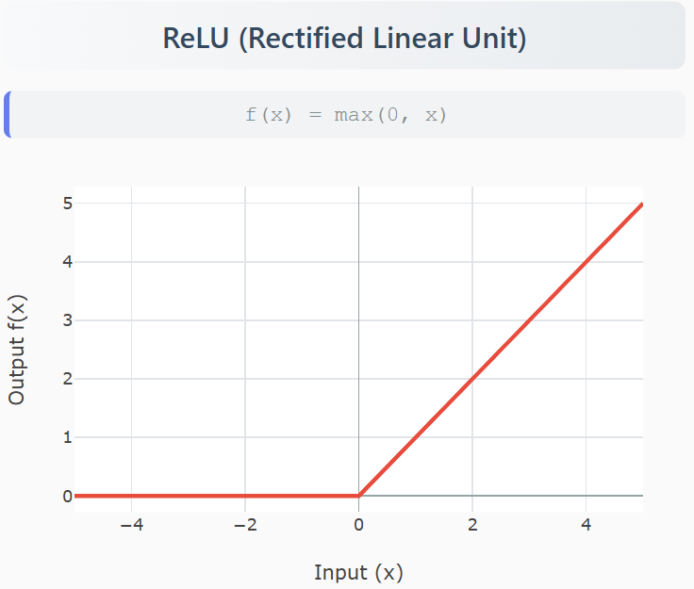
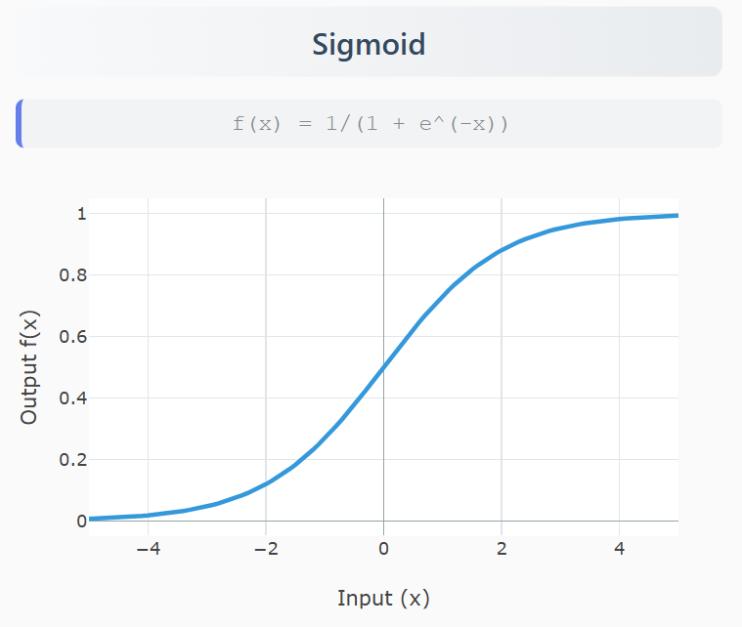
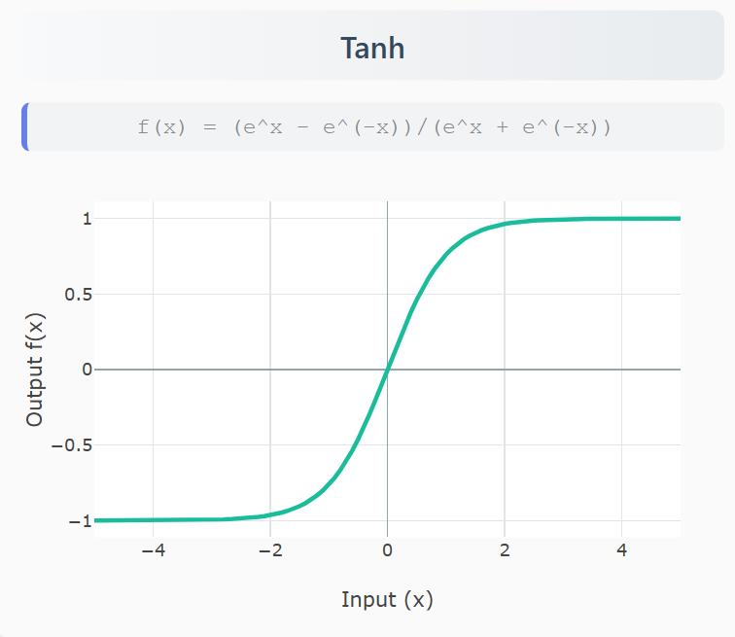
Activation
Introduce nonlinearity into the system!
Notes:
Linear functions can only solve linearly separable problems. This means:
✅ If you can’t draw a line through it, you can’t use it to separate anything.
❌ They cannot handle curved decision boundaries
❌ They cannot solve XOR problems
❌ They cannot recognize complex patterns like images, speech, or text

Slide 34
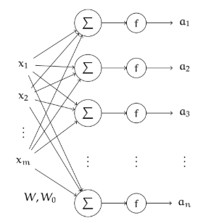


Building a Layer
$$\left[\begin{matrix}\begin{matrix}x1 & x2\end{matrix} & \begin{matrix}... & xn\end{matrix}\end{matrix}\right]∙\left[\begin{matrix}\begin{matrix}w1 \\ w2\end{matrix} \\ \begin{matrix}⋮ \\ wn\end{matrix}\end{matrix}\right]$$
$$\left[\begin{matrix}\begin{matrix}x1 & x2\end{matrix} & \begin{matrix}... & xn\end{matrix}\end{matrix}\right]∙\left[\left[\begin{matrix}w1,1 & ⋯ & w1,n \\ ⋮ & ⋱ & ⋮ \\ wn,1 & ⋯ & wn,n\end{matrix}\right]\right]$$
Notes:
If you think about it, each column is like one neuron. We can parallelize this by adding more columns to our matrix.
So, one layer is many neurons in parallel

Slide 35
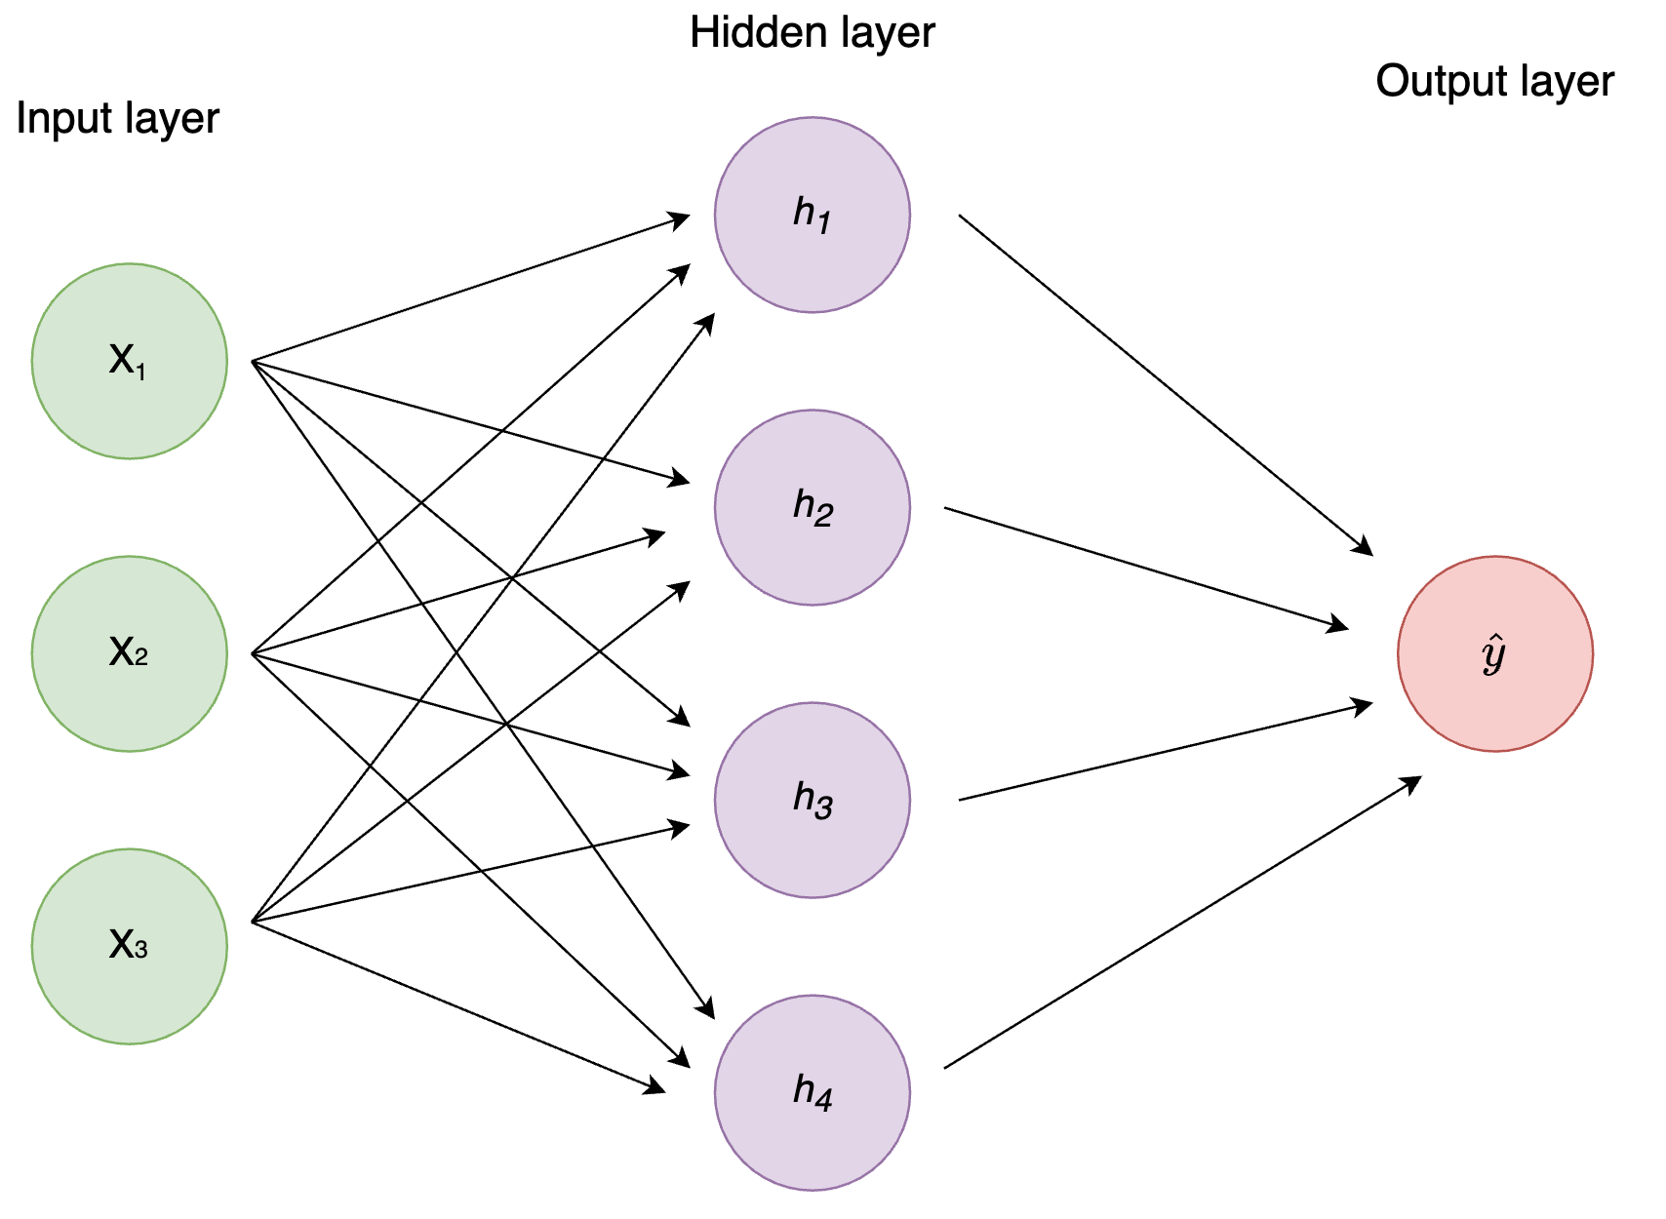
We Made It!
Notes:
We just built the most common form of AI network.
We’ll be exploring variations on this theme from here on out.

Slide 36
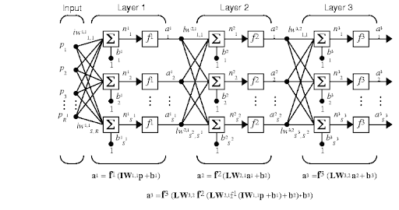
We Made It!
Notes:
We just built the most common form of AI network.
We’ll be exploring variations on this theme from here on out.

Slide 37
Open Question
We just saw how matrices can be used to manipulate data usefully.
But!
How do we pick which matrices to use?
How does this connect to backpropagation, our modern AI method?
To do that, we need one last idea to bring it all together.

Slide 38
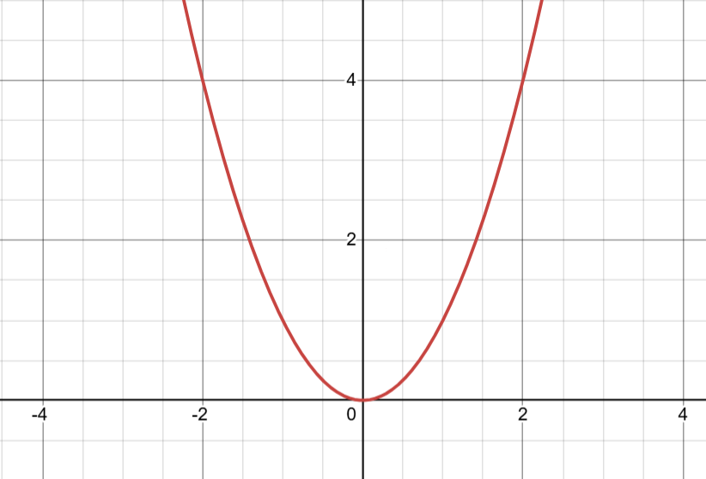
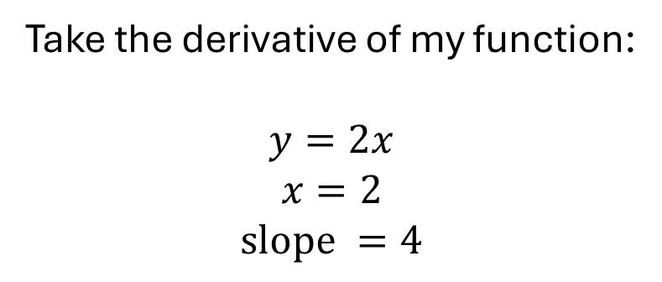

Derivatives and Gradients
Take the derivative of my function:
$$y=2x$$
$$x=2$$
$$slope =4$$
$$y=x^{2}$$
Notes:
I want to know the slope right where my dot is. How do I do that?

Slide 39
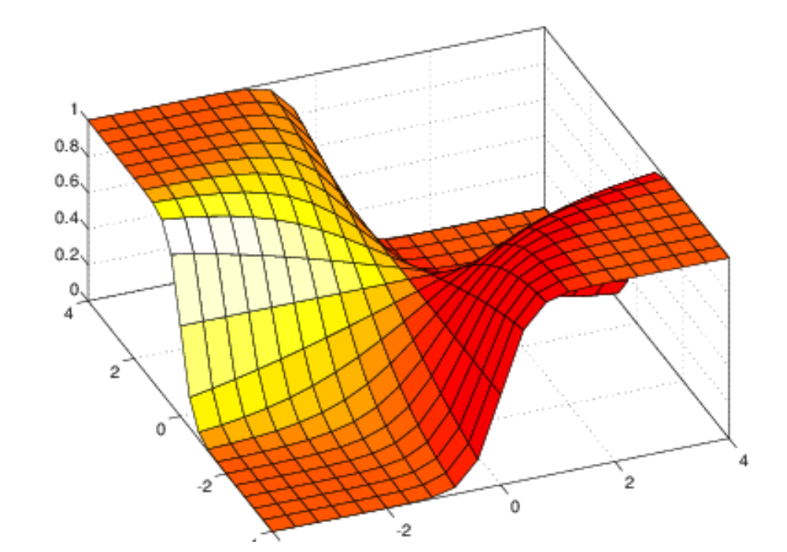
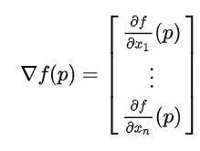
Derivatives and Gradients
Gradient: direction of greatest change
Can be on graph of any number of dimensions
Vector pointing toward this direction
Notes:
What if I asked you for the slope at this point now?
We need a concept called the gradient to describe it.

Slide 40
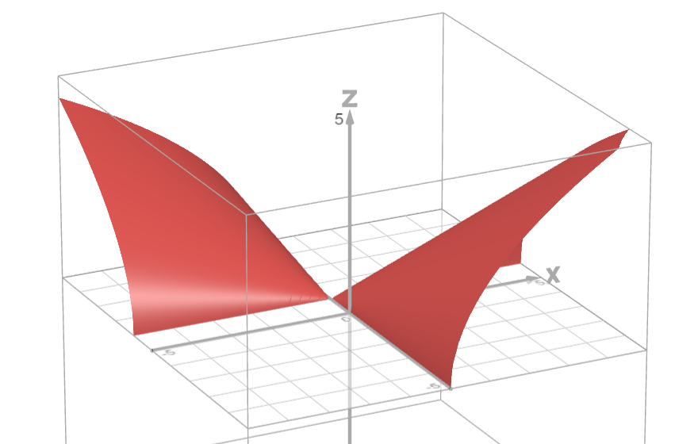
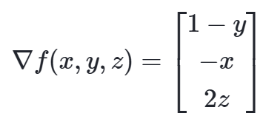
Gradient example
Holding other variables as a constant, take a derivative
We get a vector style function telling us what the gradient will be at any point
Notes:
Not something you need to remember how to compute, I include this to better illustrate what’s going on here.
(note to self set f=0, pulled over z and graphed)

Slide 41
Problems With Computing Gradient
With so many parameters in these models, near impossible to compute a global gradient function
Equations are complex and linear, making solving harder too
Idea: Only compute local gradient, take a step, and repeat

Slide 42

Gradient Descent
Algorithm:
Find gradient at start point
Move opposite that direction by an amount = gradient magnitude times a constant (learning rate)
Repeat until the value between steps changes less than a set amount (or a fixed number of times)
Notes:
What is our function surface in real life?
Well, it’s how we define success. That’s the entire subject of next lecture. It’s called our “loss function” and lower means we’ve come closer to our goal, meaning our model has learned.

Slide 43
Backpropagation
Backpropagation: Updating each layer to descend our loss fn’s gradient

Slide 44
Notes:
What we’re doing here, as it pertains to the network, is asking ourselves how we can change the numbers inside the matrix to move toward our definition of success.

Slide 45
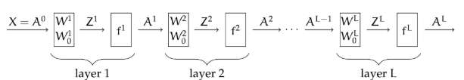
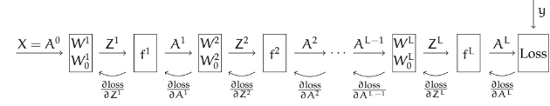
Backpropagation
Find the output of our network by plugging in an example (forward pass)
Find the gradient and update our matrix in each layer.
Notes:
This is the most dense slide we’ll run into all semester
First, do a forward pass to compute the intermediate outputs between layers, and the final output.
From there, we’ll get a score as determined by our loss function.
At every layer, we’re asking ourselves what tweak to the weights will decrease our loss function (meaning we did better).
Since a change in one layer changes the others, we compute backwards from the end updating our weights.
At the end, we have a function that scores better on our data.
How do we define “scores better?”
Stick around until next lecture

Slide 46
Now we’ve got a functioning neural network!
Notes:
So in this network, we get an output for every number. When you put in a number, you get an output at the end corresponding to the likelihood it’s each number.
We can see here that it’s number 9. So, our network predicts number 9.
We’ll circle back next time, discuss loss functions in depth and start applying what we learned today to medicine.

Slide 47
Questions?

